Slide 1
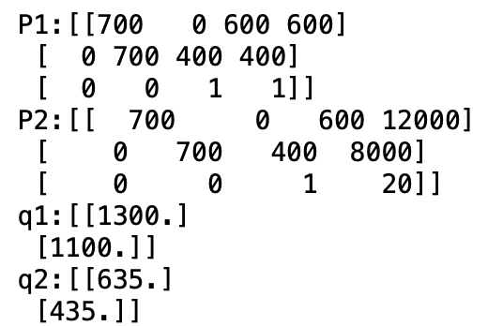
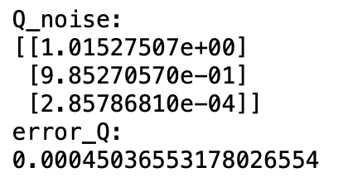
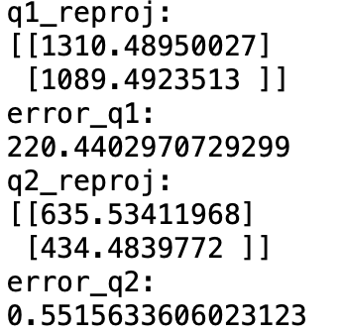
Exercise 5
5.1 Projection Matrix and Points
5.2 Triangulation and re-projection of points with noise
Exam Presentation

Slide 2
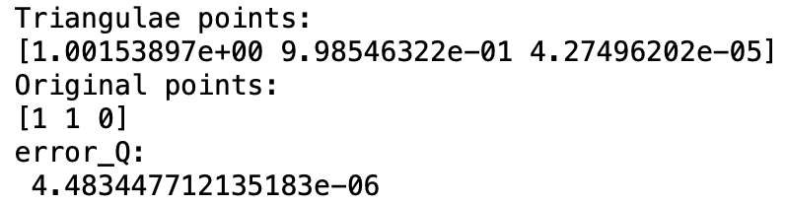
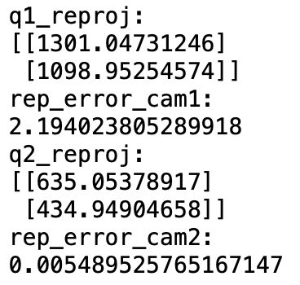
Exercise 5
5.3 & 5.4 Triangulate and re-project points with noise using non-linear optimization
Exam Presentation

Slide 3
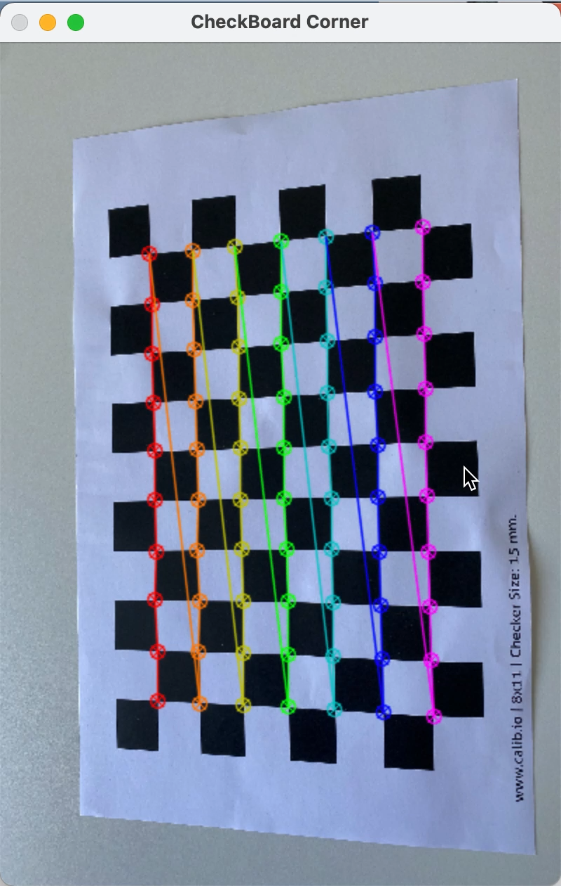
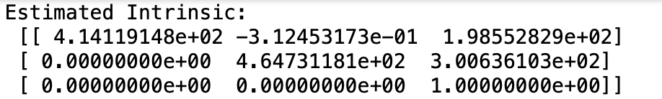
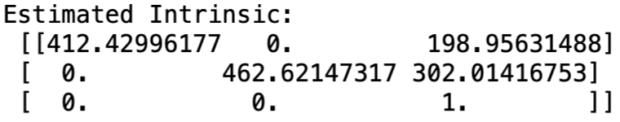
Exercise 5
5.5 & 5.6 & 5.7 Use CheckerBoard to Calibrate Camera
Find CheckerBoard Corners
Calibrate by self-function
Calibrate by cv2.calibrateCamera
Exam Presentation

Slide 4
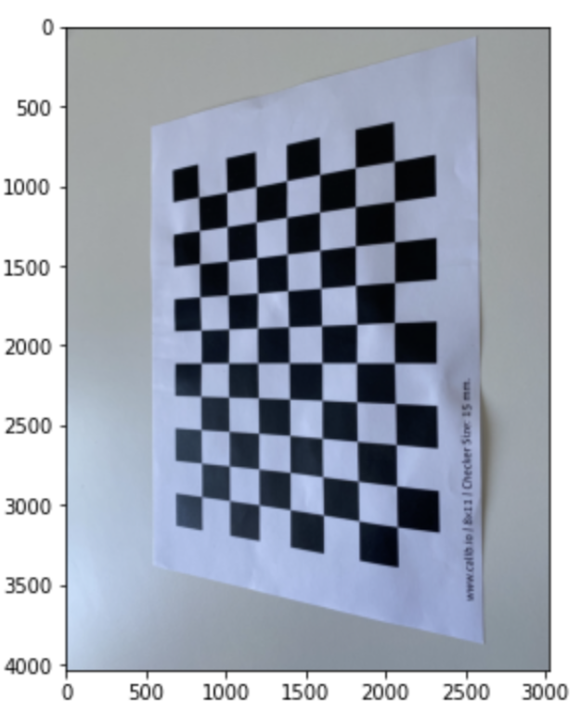
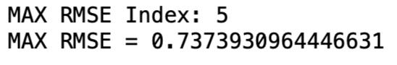
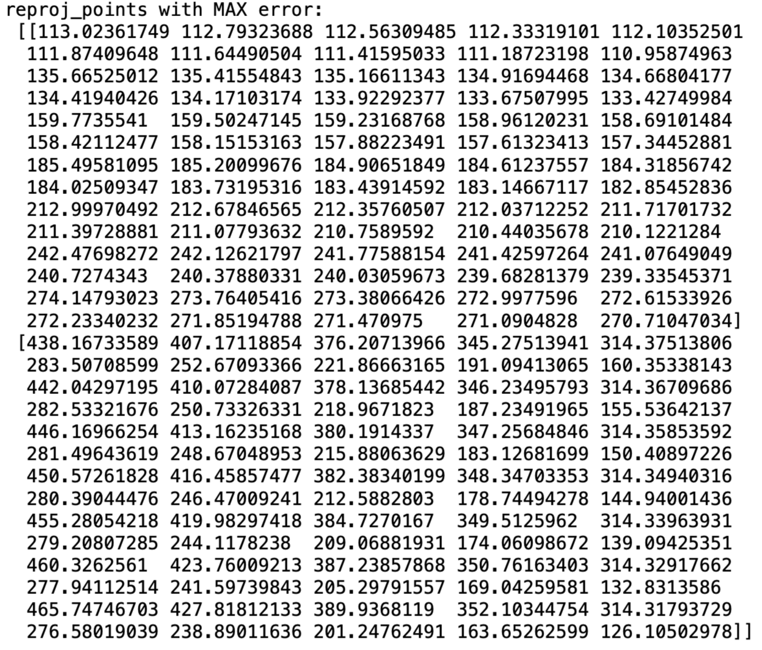
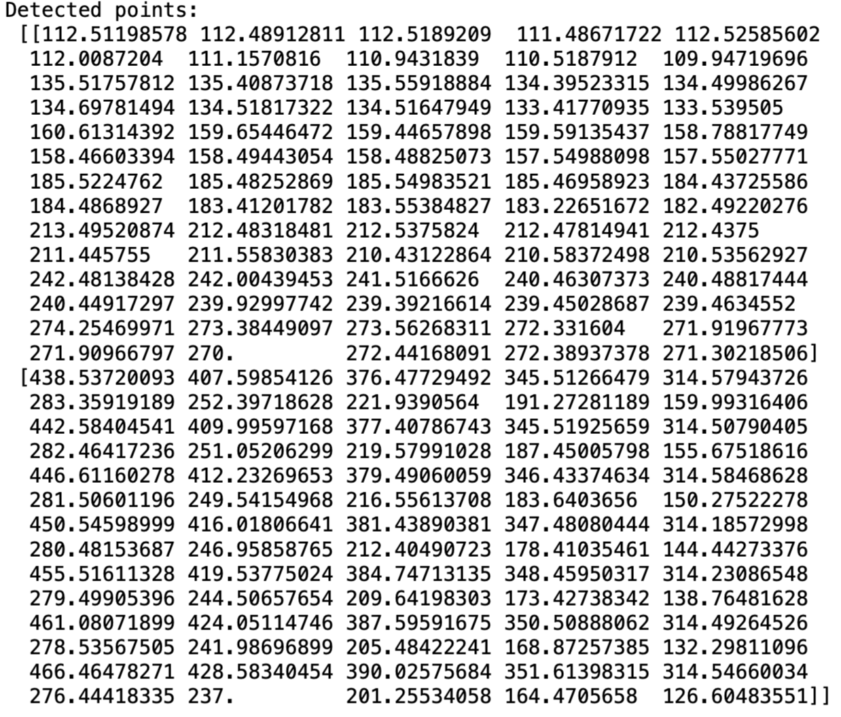
Exercise 5
5.8 & 5.9 Re-project Points and Find Max RMSE Error without Distortion Coefficients
Exam Presentation

Slide 5
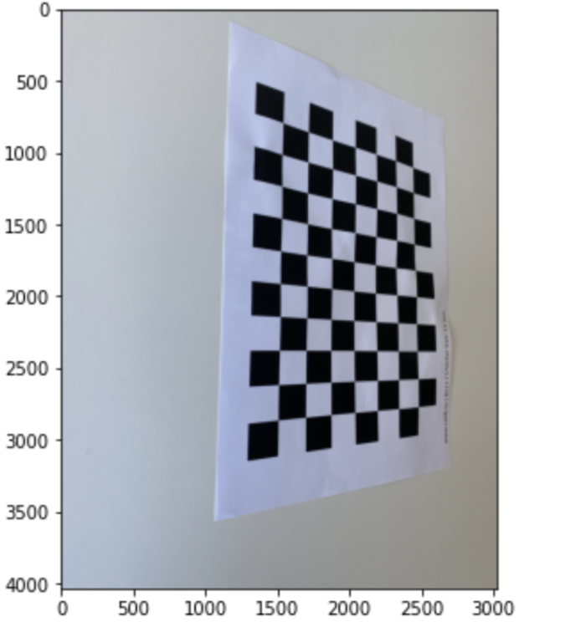

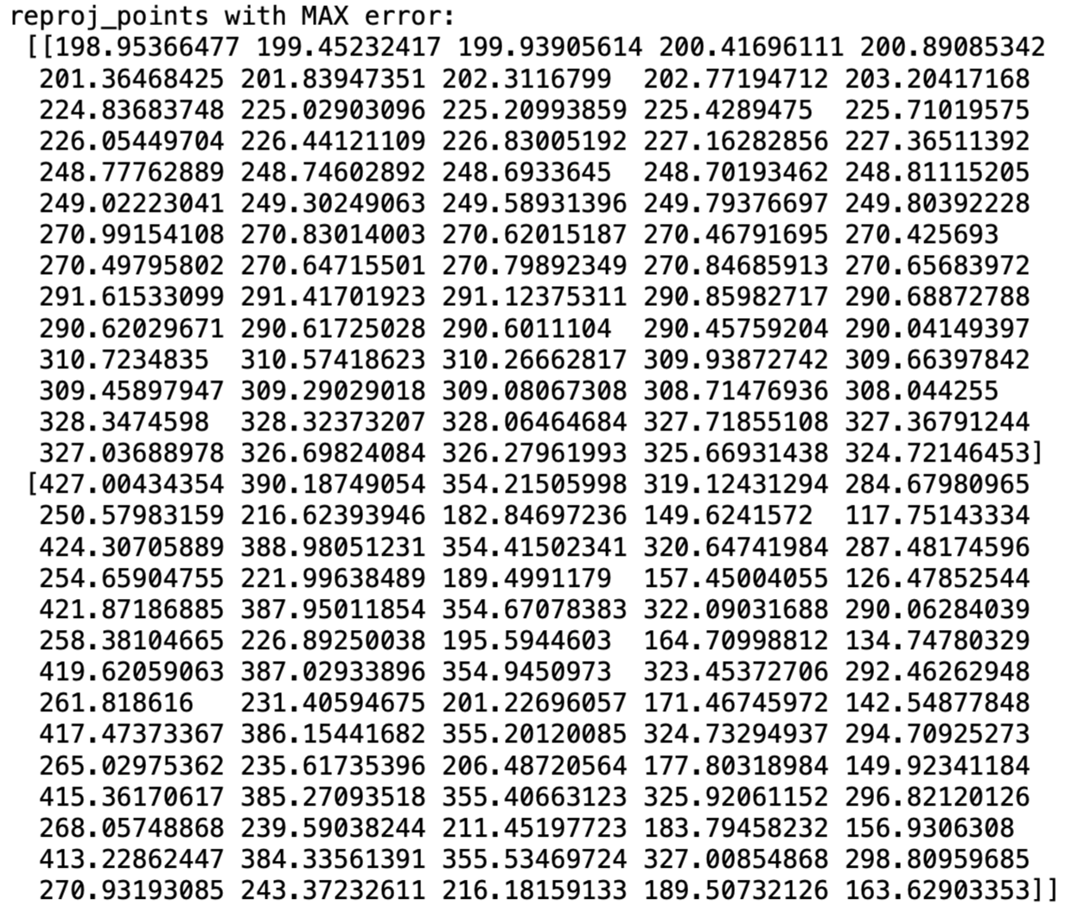
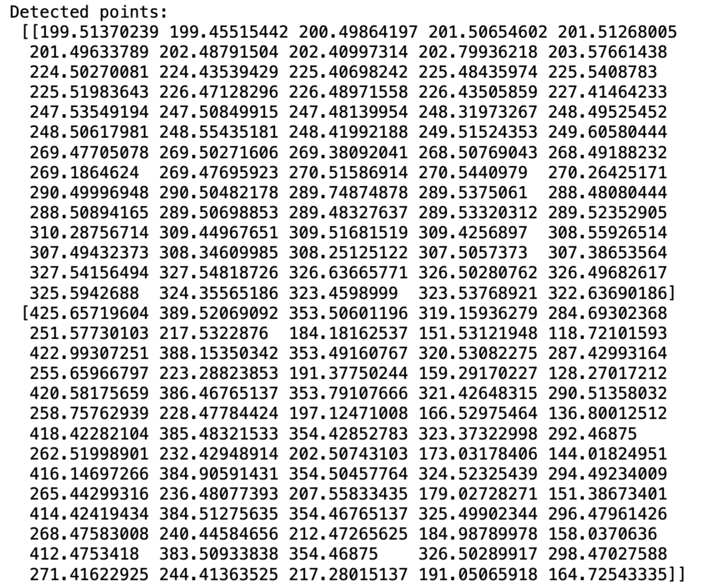
Exercise 5
5.8 & 5.9 Re-project Points and Find Max RMSE Error with Distortion Coefficients
Exam Presentation

